Slide 1

Limit Reference Points and the Fish Stocks Provisions
Joint TESA/NOG Workshop
Break-out Group Exercise 2
December 1 2021

Slide 2
Agenda

Slide 3
Exercise 2
Exercise Goal:
Identify ways to define an LRP for Arctic Sardine MU1 in a data-rich context.

Slide 4

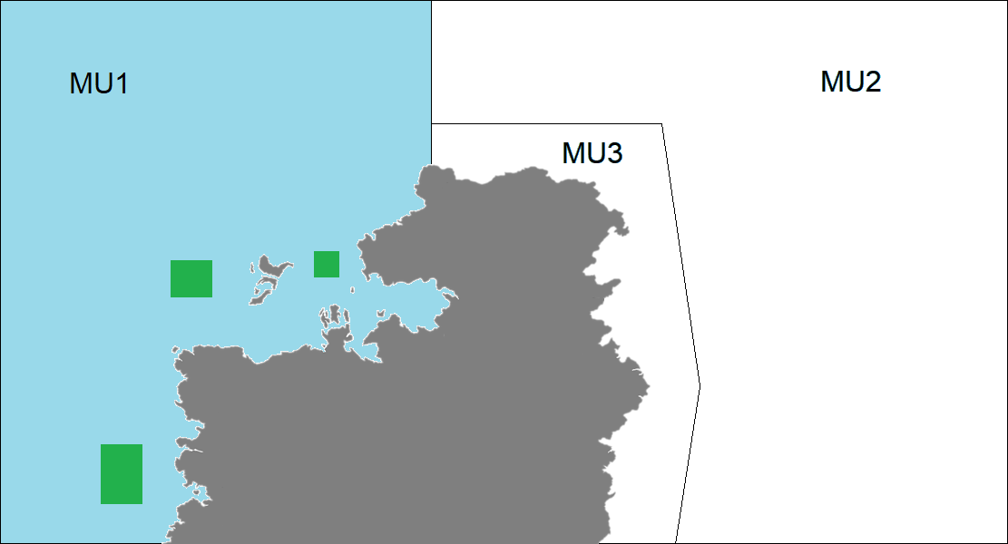
Exercise 2
Age structured model in MU1
B-H SRR with h = 0.75
M = 0.3
Catch and age composition data (50 yrs)
Acoustic surveys (Index of SSB) (25 yrs)
A purse seine fleet and a gill net fleet
System dynamics are assumed to be at equilibrium (i.e., vital rates are assumed to be stationary)

Slide 5
Exercise 2
Evaluate at least 3 approaches to defining an LRP for Arctic Sardine MU. Identify the “preferred” approach

Slide 6
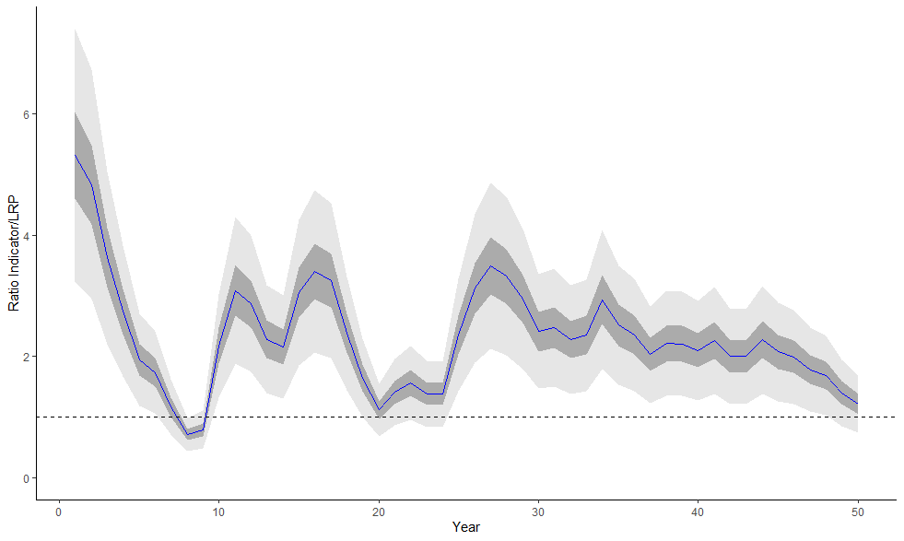
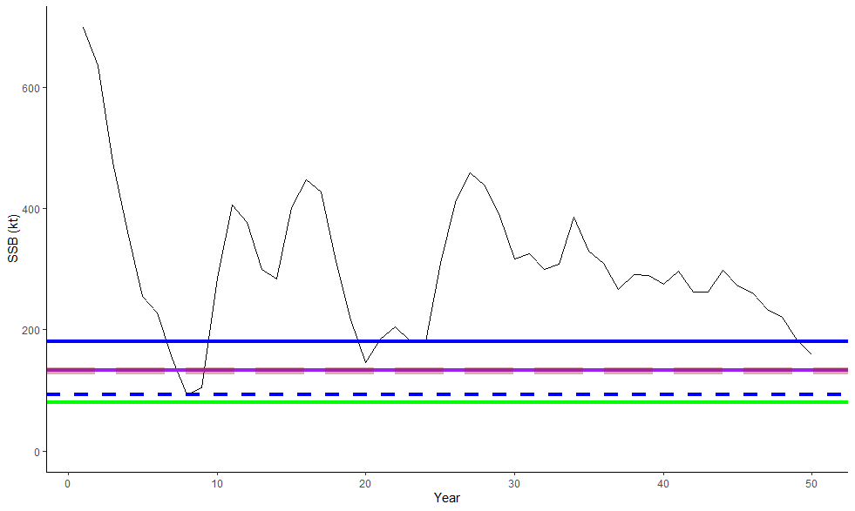
Break Out Group 6
Indicator: SSB
LRP: Ave(4 LRPs)
Rationale:
No clear best/worst candidate
Stock Status:
~75% probability LRP
Longterm trend noted

Slide 7
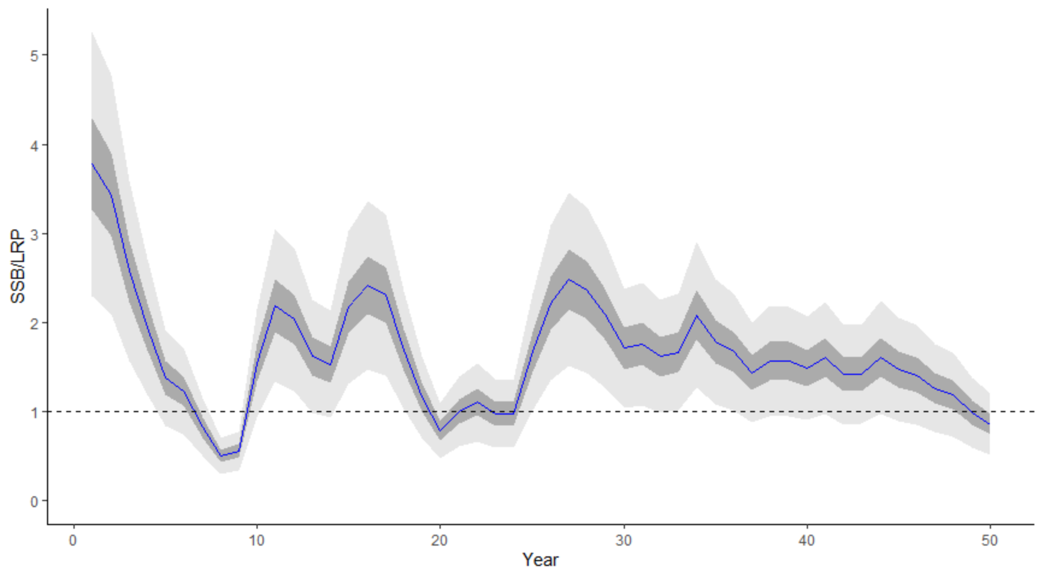
Break Out Group 5
Indicator: Model-based SSB - B recover
LRP: SSB = 185 kt
Rationale: B recover = average SSB during a period of assumed near-average recruitment (years 19-24). We chose more precautionary i.e., higher LRP (as opposed to ones based on B0/Bmsy) because productivity appeared to be declining. We did not use LRPs based on B0 because we did not feel that beginning of time-series represented unfished biomass.
Stock Status: Critical zone
Submit all slides to Tim.Barrett@dfo-mpo.gc.ca when complete

Slide 8
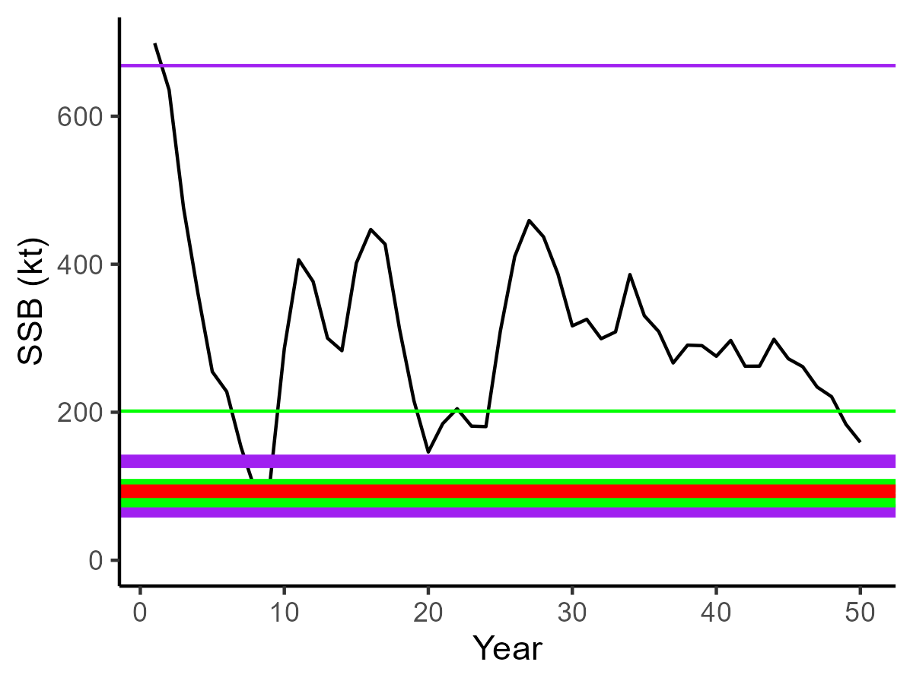
Break Out Group 4
Indicator: SSB
LRP: B_{recover}
Rationale:
Consistent with other metrics for LRPs
(40%- 50% B_{MSY}, 10-20% B₀)
Easy to communicate to FM and
stakeholders
Stock Status:
Above LRP but trending towards the LRP

Slide 9
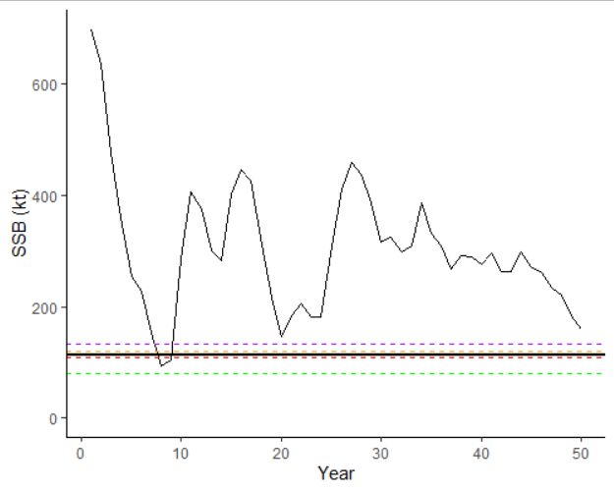
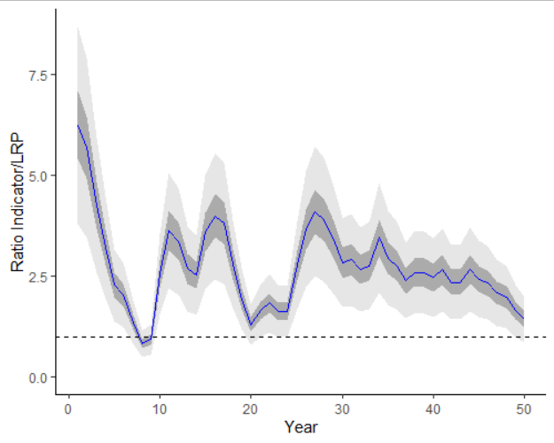
Break Out Group 3
Indicator: SSB
LRP: model average of (BRecover from 2 lowest dips), 50% of median yr25-50, 40% SSB at FatSPR40, 20% B0, 40%BMSY),
Rationale: models with different assumptions gave similar results; hard to reconcile appropriateness of different assumptions
Stock Status: above LRP with only a small of being below

Slide 10
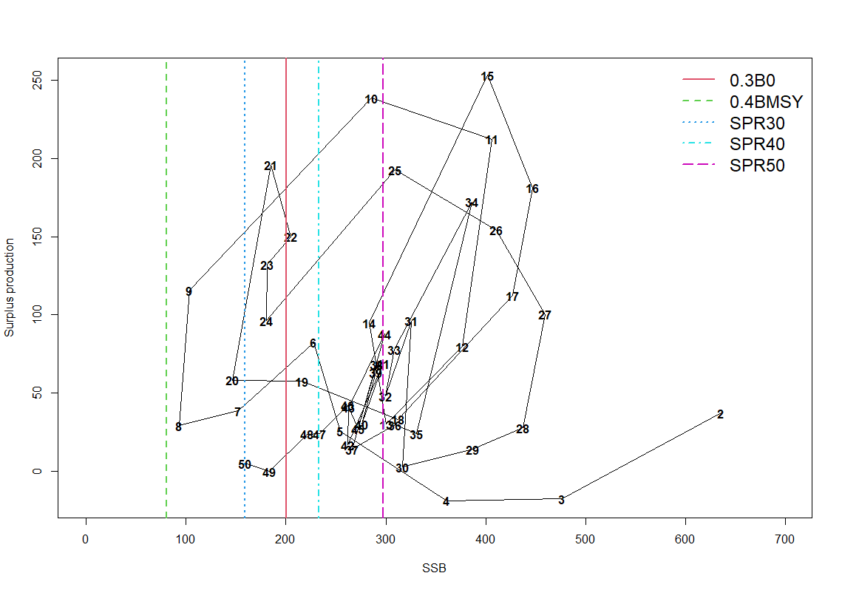
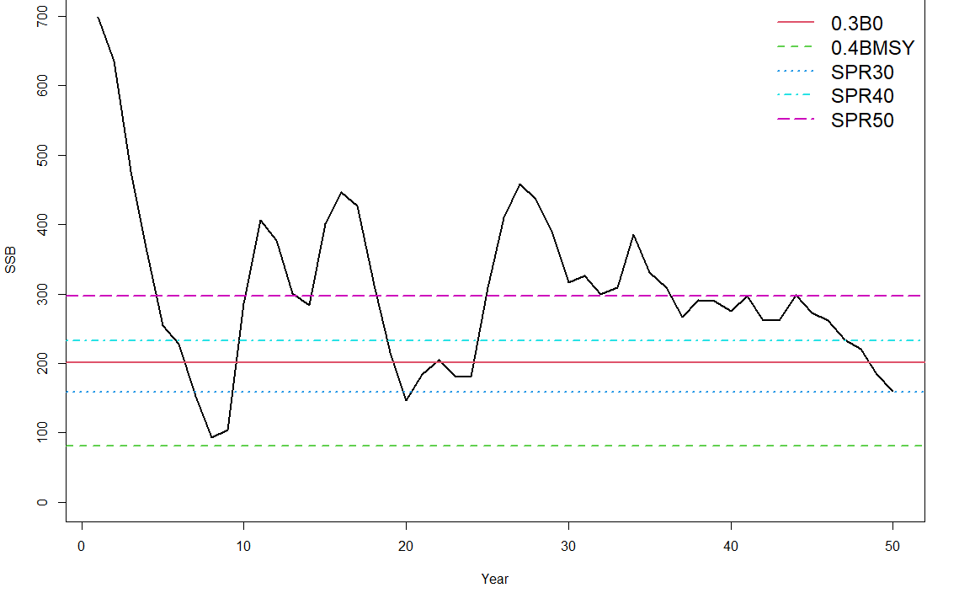
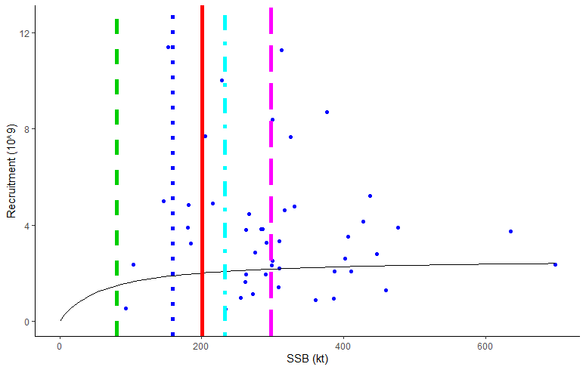
Break Out Group 2
Surplus production vs biomass
Indicator: Biomass and Surplus Production vs Biomass
LRP: SSB_SPR40 (232.7t) or SSB_SPR50 (297.1t)
Rationale: SSB_SPR40 is a fairly common reference point for many stocks (~FSPR40 has also been suggested as a proxy for Frep for pelagics). In this study, SSB_SPR40 and SSB_SPR50 are just below or above, respectively, a knot of “medium biomass low productivity” at the end of the time series, before the stock shifts to a lower biomass zero productivity state. Setting the LRP around this area could arrest further decline. The time series shows the stock can still recover from a state around 200-300 t but it is currently at a productivity low. Would need to consult with managers, partners and stakeholders before determining LRP. (Projections would be done using Fspr40 =0.2 or Fspr50=0.15).
Stock Status: Below the LRP, critical
Biomass
Recruitment

Slide 11
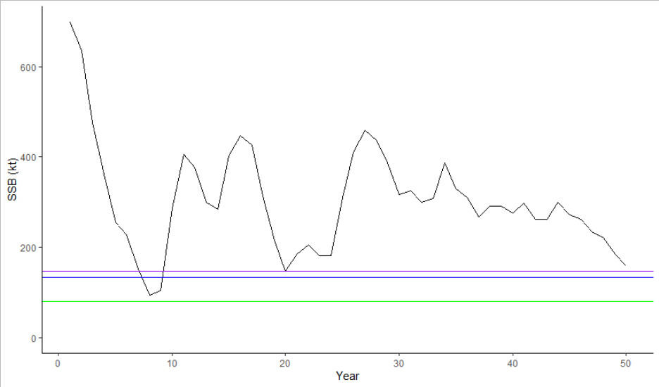
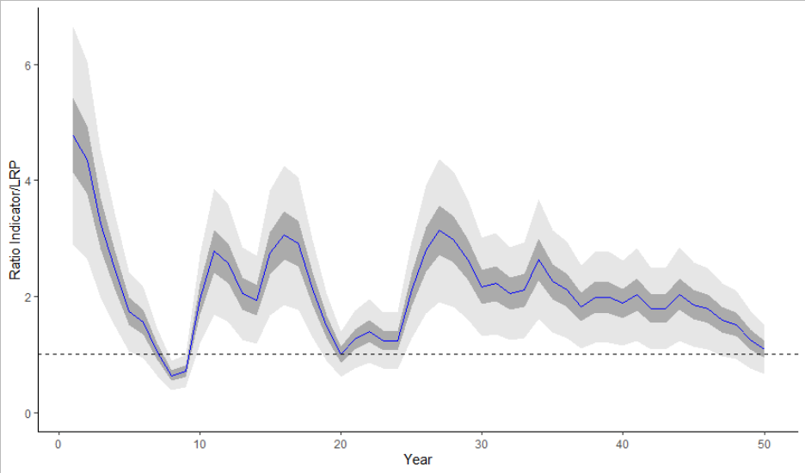
Break Out Group - MAR
Brecover
0.2SSB0
0.4SSBmsy
Indicator: Brecover
LRP: 146 kt
Rationale:
Independent of SR
Historic proof of concept, confident as recovered twice.
Close to lowest, so no foregone yield issues
Consistent with 0.2SSB0
Meets 3 of 4 criteria, with 4th (serious harm) not met because we don’t know.
Stock Status: Critical Zone (25% risk of being below LRP)

Slide 12

Exercise 2 Summary from 6 Groups

Slide 13
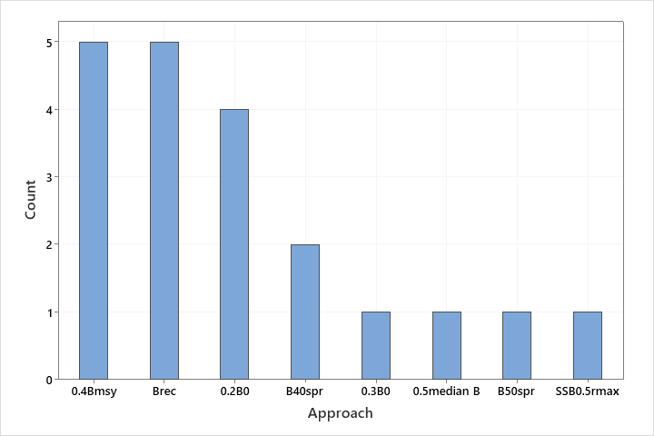
Approaches considered

Slide 14
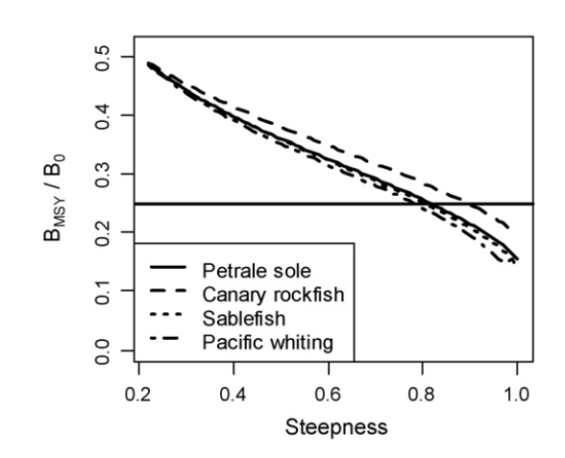
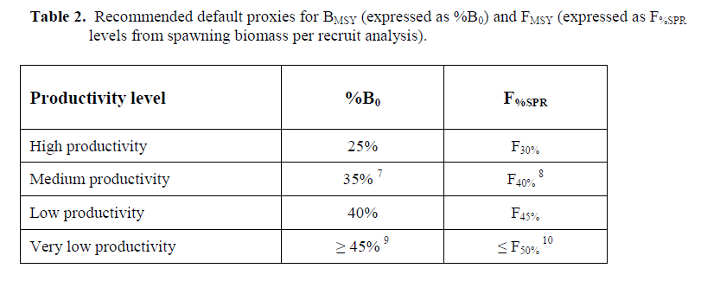
Considerations B_{MSY} vs. B₀
B_{MSY}/B₀ = 0.30 for Arctic Sardine (h = 0.75)
0.4 B_{MSY} = 0.12 B₀ for Arctic Sardine
Punt et al. 2008
Operational Guidelines for NZ’s Harvest Strategy Standard 2011

Slide 15

Preferred Approaches
SSB_{rec}
Mean across multiple approaches
$${SSB}_{F_{SPR40}}$$

Slide 16
Preferred Approaches Stock Status
SSB_{rec}
Mean across multiple approaches
$${SSB}_{F_{SPR40}}$$
>LRP
>LRP
<LRP
>LRP
<LRP
<LRP

Slide 17
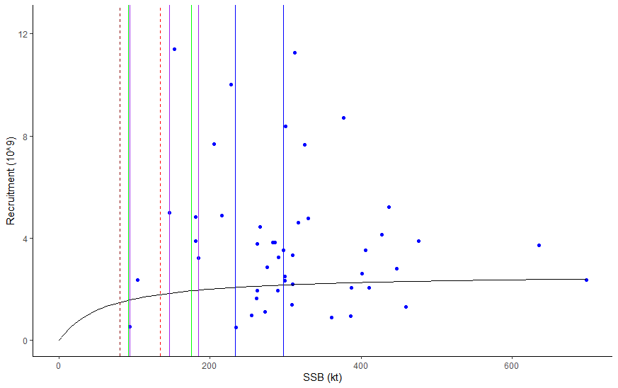
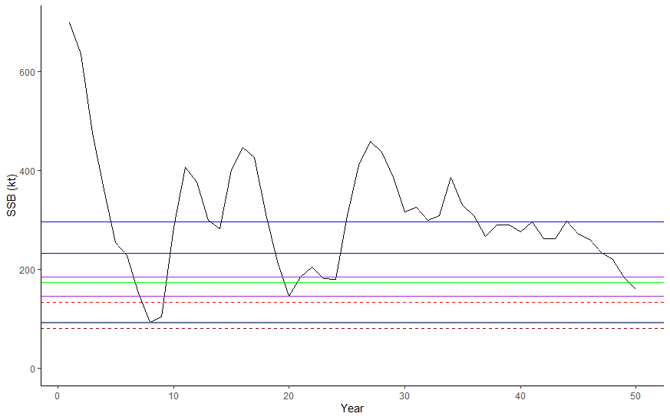
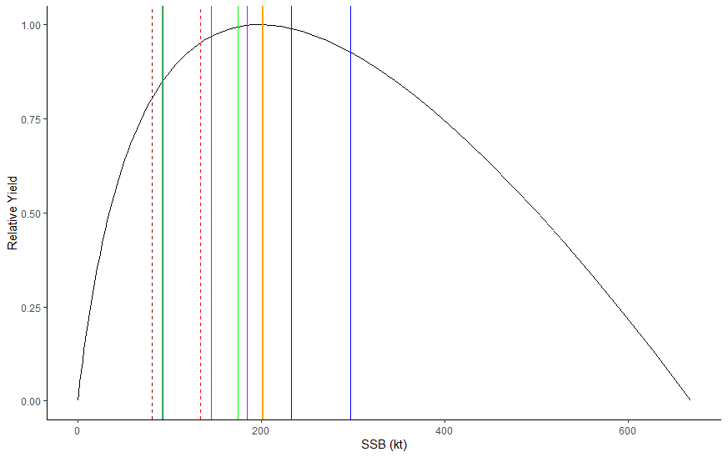
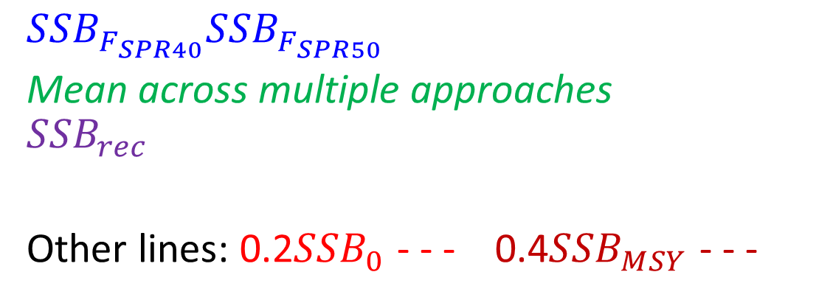

Preferred Approaches
$${SSB}_{F_{SPR40}}{SSB}_{F_{SPR50}}$$
Mean across multiple approaches
$${SSB}_{rec}$$
Other lines: 0.2${SSB}_{0}$ - - - 0.4${SSB}_{MSY}$ - - -
Year 50
$${SSB}_{MSY}$$
Year 50

Slide 18
Comparisons to SSB
Approach | LRP (kt) | Status in Year 50 SSB/LRP
mean | 92.1 | 1.73
Brec | 93.2 | 1.71
Brec | 146 | 1.09
mean | 175 | 0.91
Brec | 185 | 0.86
SPR40 | 233 | 0.68
SPR50 | 297 | 0.54

Slide 19
Comparisons to SSB
Approach | LRP (kt) | Status in Year 50 SSB/LRP | LRP/SSB_{MSY}
mean | 92.1 | 1.73 | 0.46
Brec | 93.2 | 1.71 | 0.46
Brec | 146 | 1.09 | 0.72
mean | 175 | 0.91 | 0.87
Brec | 185 | 0.86 | 0.92
SPR40 | 233 | 0.68 | 1.16
SPR50 | 297 | 0.54 | 1.47

Slide 20
Comparisons to SSB
Approach | LRP (kt) | Status in Year 50 SSB/LRP | LRP/SSB_{MSY} | LRP/SSB₀
mean | 92.1 | 1.73 | 0.46 | 0.14
Brec | 93.2 | 1.71 | 0.46 | 0.14
Brec | 146 | 1.09 | 0.72 | 0.22
mean | 175 | 0.91 | 0.87 | 0.26
Brec | 185 | 0.86 | 0.92 | 0.28
SPR40 | 233 | 0.68 | 1.16 | 0.35
SPR50 | 297 | 0.54 | 1.47 | 0.44

Slide 21
Discussion points
How did the SRR influence your choice?
For this stock – all preferred LRPs were > 0.4SSB_{MSY}
When is SSB_{MSY} not reliable or an appropriate basis for an LRP?
Advantages of combining multiple approaches?
Links to serious harm
Is there a preferred approach? (Live survey in Teams)
Comments from external experts

Slide 22
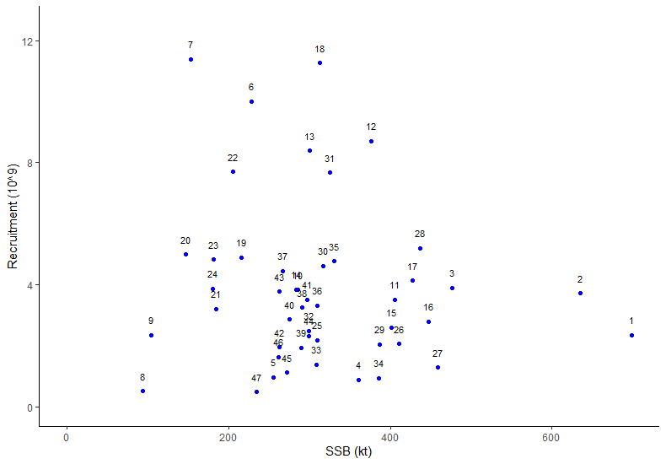
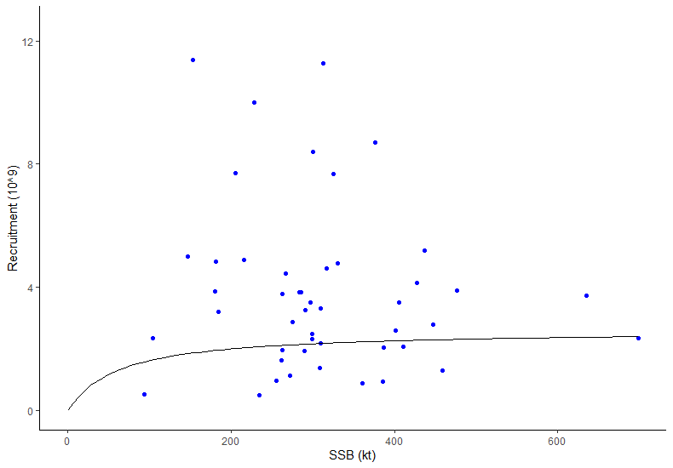
SRR
B-H, assumed h = 0.75

Slide 23

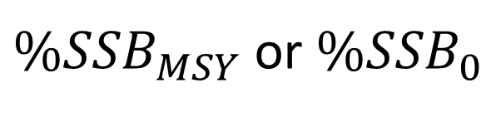
${\%SSB}_{MSY}$ or ${\%SSB}_{0}$
Serious Harm
𝑇ℎ𝑟𝑒𝑠ℎ𝑜𝑙𝑑 𝑓𝑜𝑟 𝑎𝑣𝑜𝑖𝑑𝑖𝑛𝑔 𝑙𝑜𝑤 𝑝𝑟𝑜𝑑𝑢𝑐𝑡𝑖𝑣𝑖𝑡𝑦/
𝑙𝑜𝑤 𝑏𝑖𝑜𝑚𝑎𝑠𝑠
$${SSB}_{rec}$$

Slide 24
Candidate Criteria for Best-Practice Indicators and LRPs:
Consistent with an objective to avoid serious harm to the stock
Based on the best available information
Operationally useful
Reliably estimated

